Slide 1
Support for On-Premises Deployments
Progress Report
March 2024

Slide 2
Workstream History
For reasons of efficiency, cost minimisation and convenience, much of the early Mojaloop software development and testing process was performed in public cloud infrastructure.
Current and upcoming Mojaloop operating environments require private data centre infrastructure.
Efforts have successfully added capability to the Mojaloop deployment and maintenance tools (IaC) for private data centre scenarios.
Work continues to streamline and enhance this capability further

Slide 3
Workstream Objectives
To make the process of deploying and maintaining Mojaloop software in private data centres reliable, quick, easy and cheap.
Enable starting small to minimise initial capex but with cheap unit cost to add capacity as traffic grows
No license fee technology in the tool set
Facilitate “carrier grade” security, reliability and resilience
Support well known, tried and tested components and infrastructure patterns

Slide 4
On Premises Workstream Highlights
Secure OS layer (Kairos immutable Linux) tests continue:
Adopter testing continues. Grateful thanks!
Self-serve IaC install documentation produced and being iterated
Full support for node affinities and taint/tolerations for workload segregation
On-Premises monitoring stack enhancements
Cluster and application metrics and health
Default dashboards
Istio gateway replacing WSO2 done (Keycloak and Ory stack IAM)
Work in progress eliminating last few remaining control centre cloud dependencies (moving aws s3 to minio - in progress)
Enables fully air-gapped on-premise Mojaloop deployment

Slide 5
Workload Segregation Support
Changes made to mojaloop values file to provide affinities and/or tolerations
IaC modified to configure nodes with appropriate labels and/or taints
Fully configuration file driven within IaC
Labels provided by earlier workstream deliverable
Tested both on Bare Metal as well as AWS

Slide 6
Monitoring Stack Update
K8s centric self contained monitoring infrastructure is in place using IAC and GitOps approach
Monitoring stack is highly configurable via IAC
Built on top of industry tested open source tools such as Prometheus, Grafana and Loki
Extremely flexible to absorb extensions by the use of K8s custom resources and operators.
Comes with a rich set of pre-configured dashboards (20 plus) for monitoring K8s cluster, nodes, databases and mojaloop, out of the box
Adding custom dashboards and new monitoring targets is GitOps native and developer friendly
WIP: Adding alerts and paging channels to notify unhappy events

Slide 7
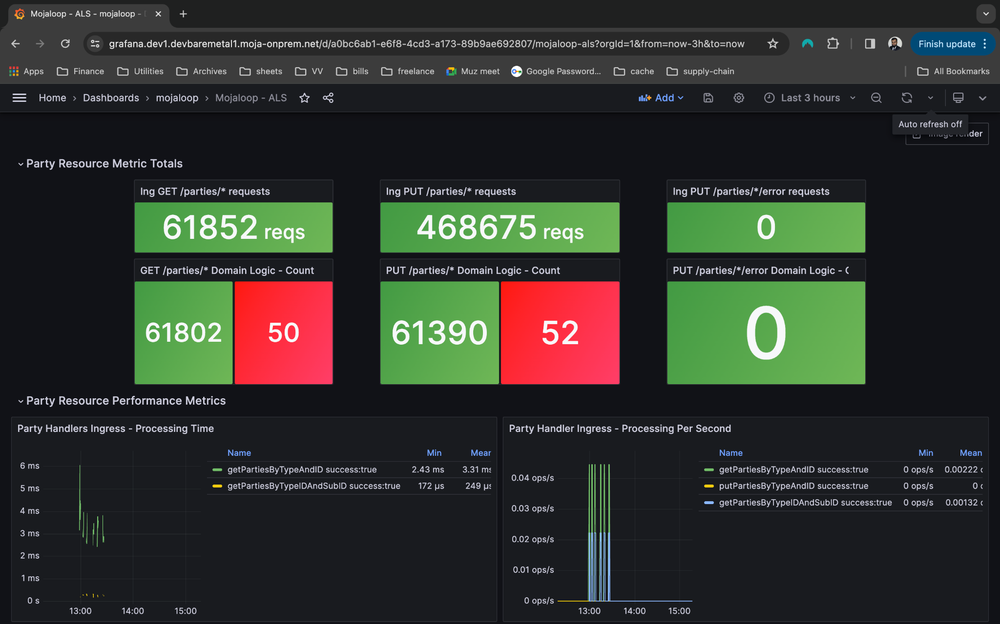
Monitoring Stack - Account Lookup dashboard

Slide 8
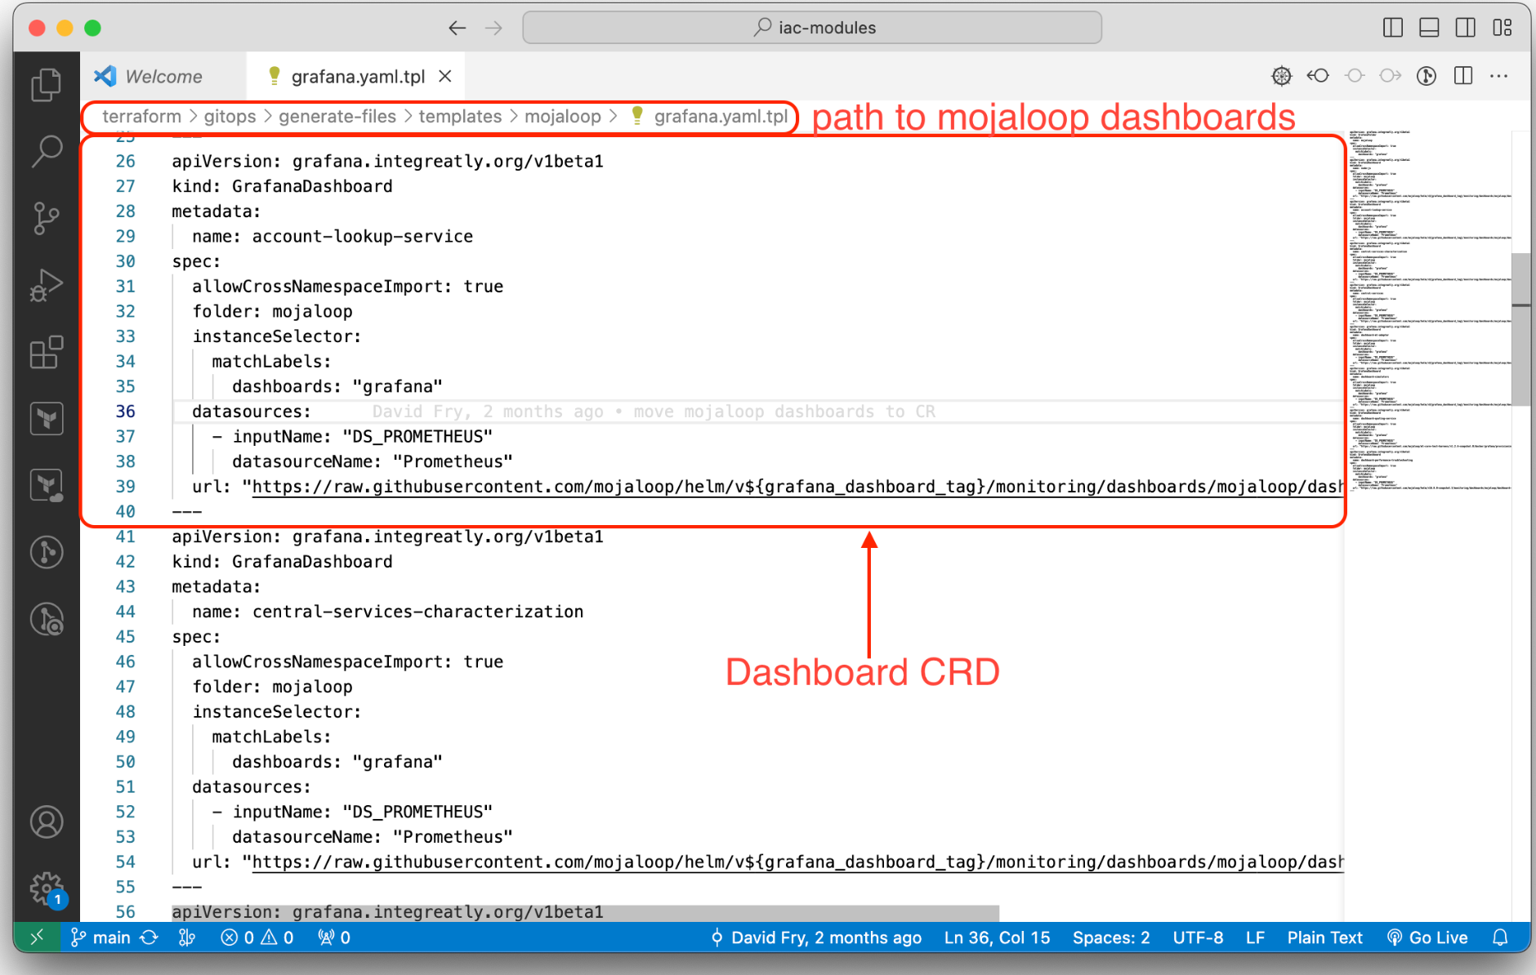
Monitoring Stack - Account Lookup CRD

Slide 9
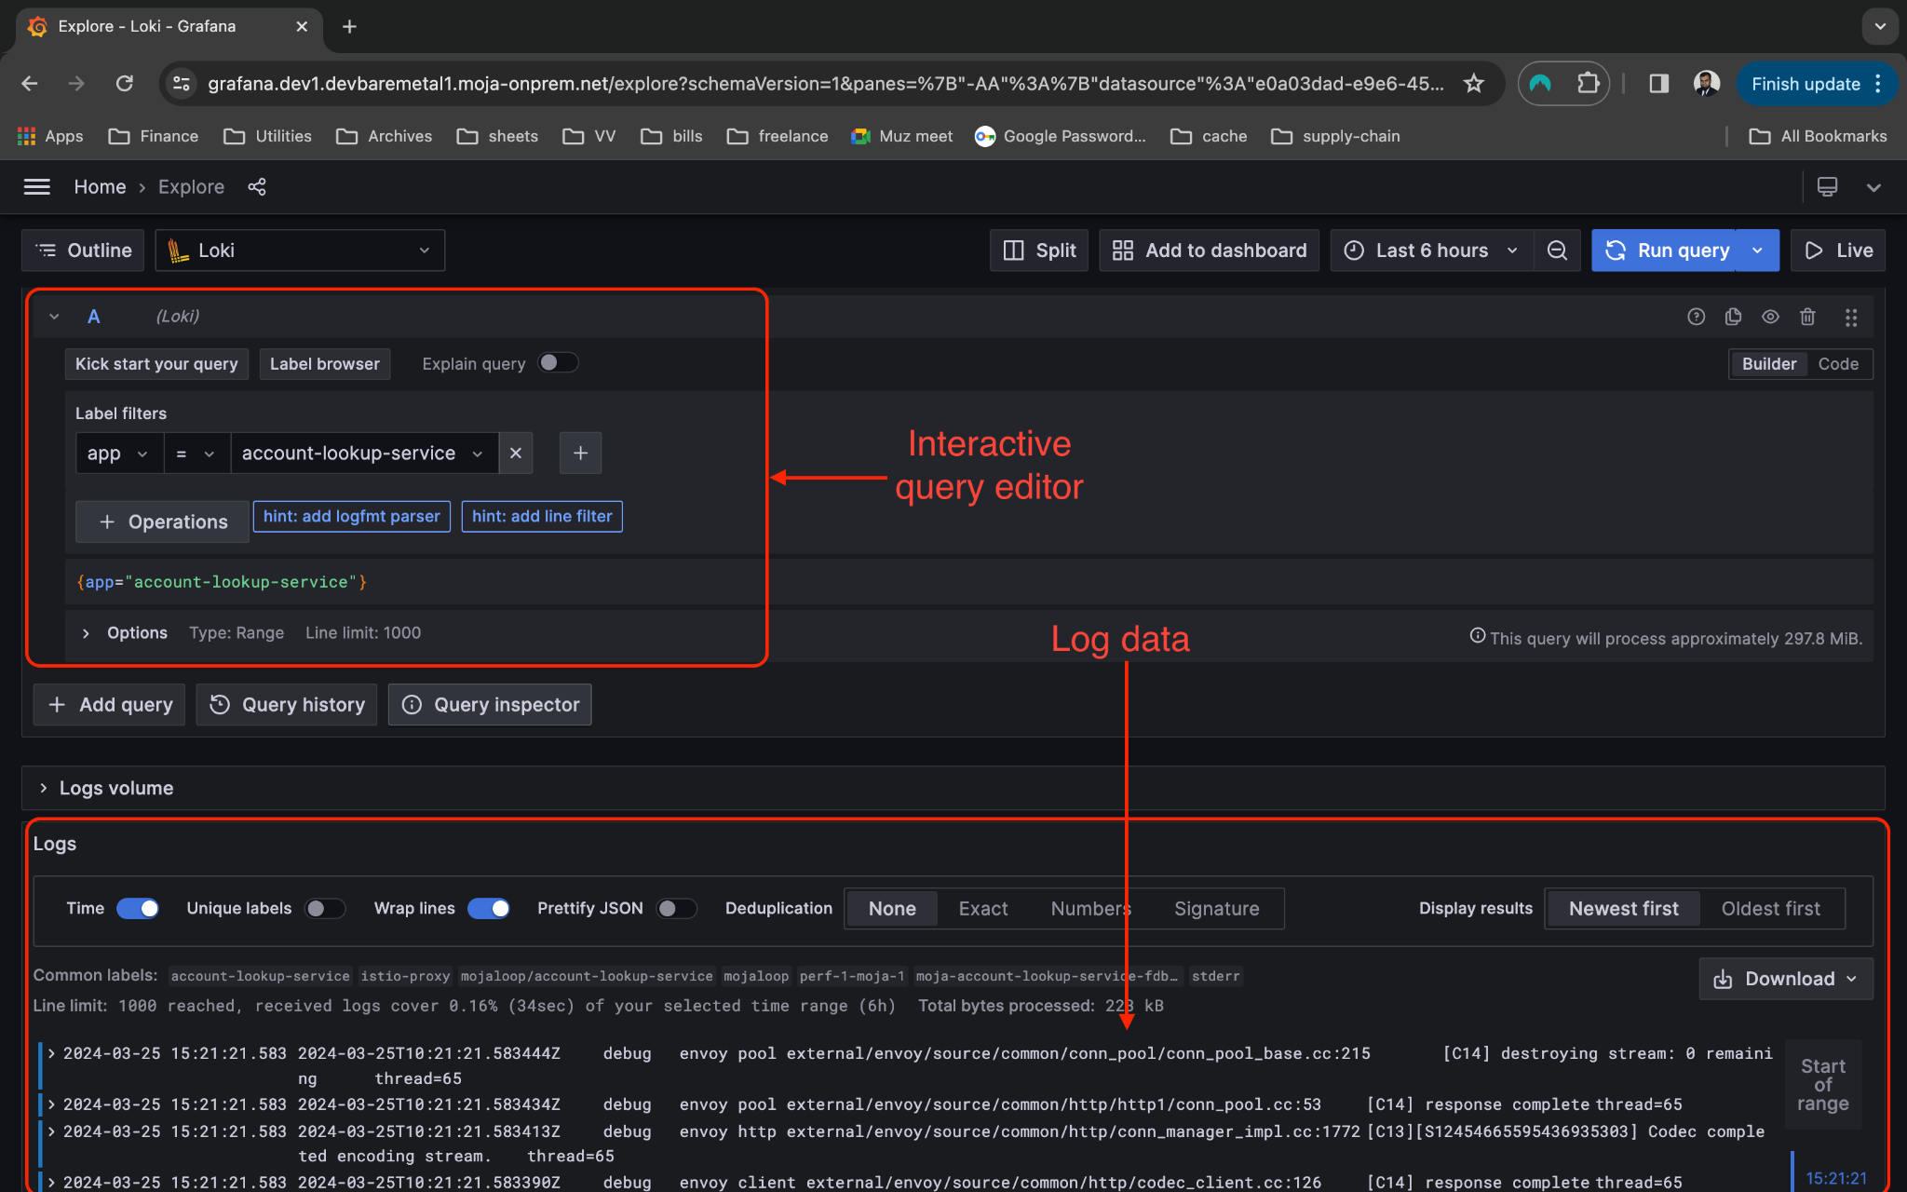
Monitoring Stack - Log explorer

Slide 10
How to add new mojaloop services to
monitoring stack?
Notes:
In this talk, I will show you how we can add more services to mojaloop monitoring stack and how we can add custom dashboards to query and display the monitored data

Slide 11
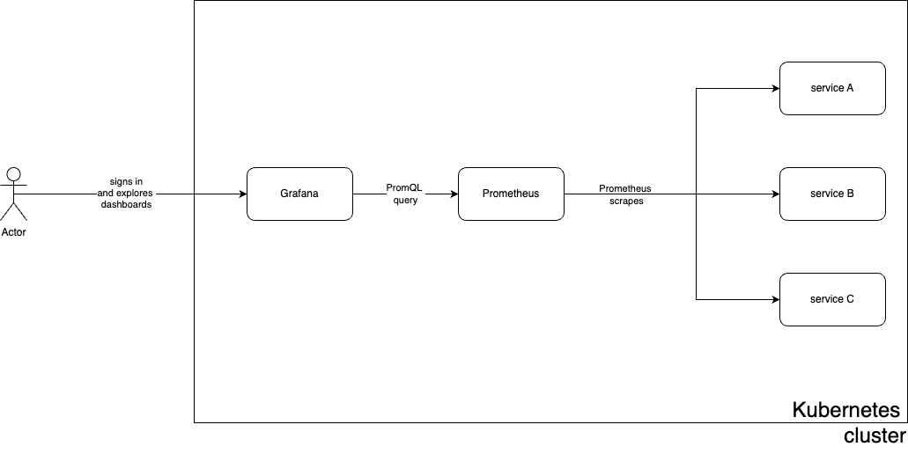
Monitoring infra architecture - simplified
Notes:
Before we go ahead, just a quick overview of architectural background. We are using Prometheus for scraping metric data. Grafana is using as a visualization tool for displaying the metric data. In addition to metrics, grafana is also being used for querying and displaying logs.
All of this is deployed via kubernetes centric approach using helm charts which means we can also leverage prometheus and grafana operators to manage our customizations. And it will become clear how we are doing that in a second.

Slide 12
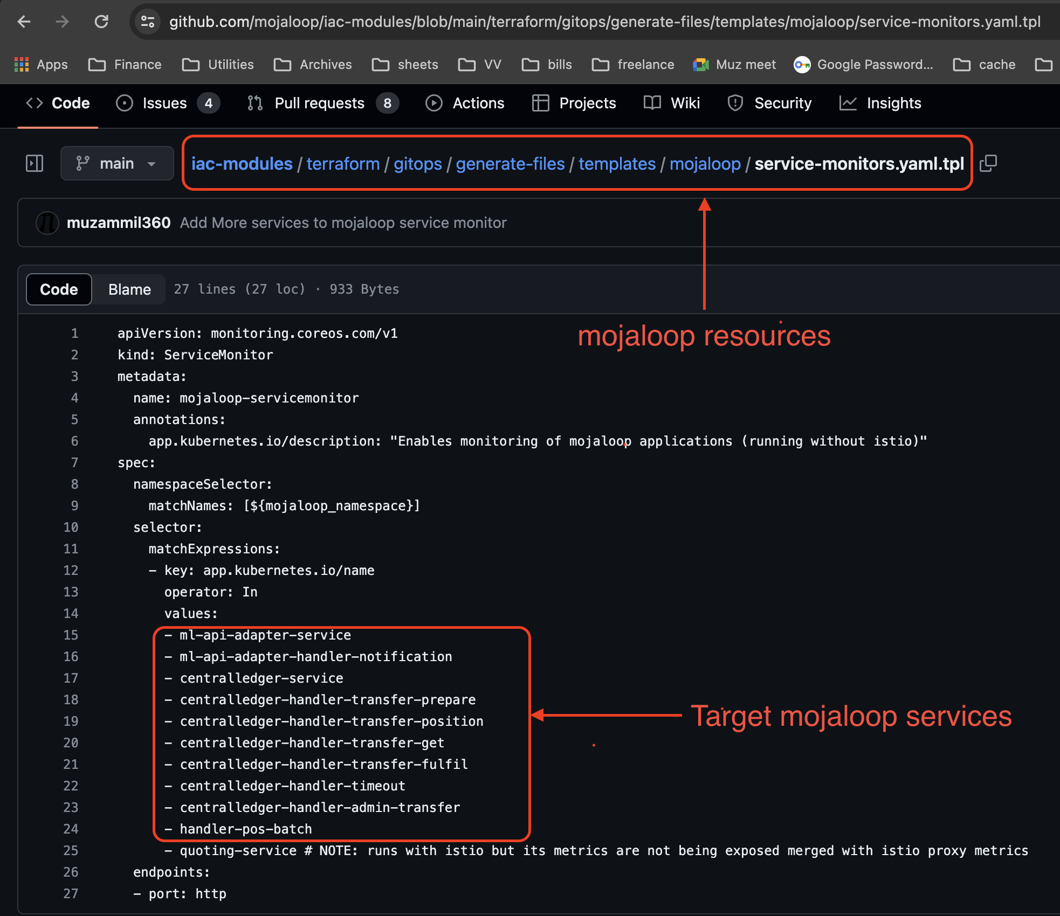
Adding new mojaloop services to Prometheus
Add new target service to existing list
Make sure metrics are available on port named “http”
No restriction on port number
Notice mojaloop namespace as opposed to monitoring
Notes:
So in order to add a new service to prometheus scrape target list, we are going to update the mojaloop service monitor. Over here you can see, we already have a list of other services we are already monitoring. Likewise, we just need to add the name of new services to this list, and we are done.
Well almost, we just need to take care of one thing that the metrics are exposed on the port which is named as “http”. If the port name is missing or mis-configured, then Prometheus wouldn’t able to scrap the metrics. Please note that you can use whatever port you want, as long as it’s named properly, it should be fine.

Slide 13
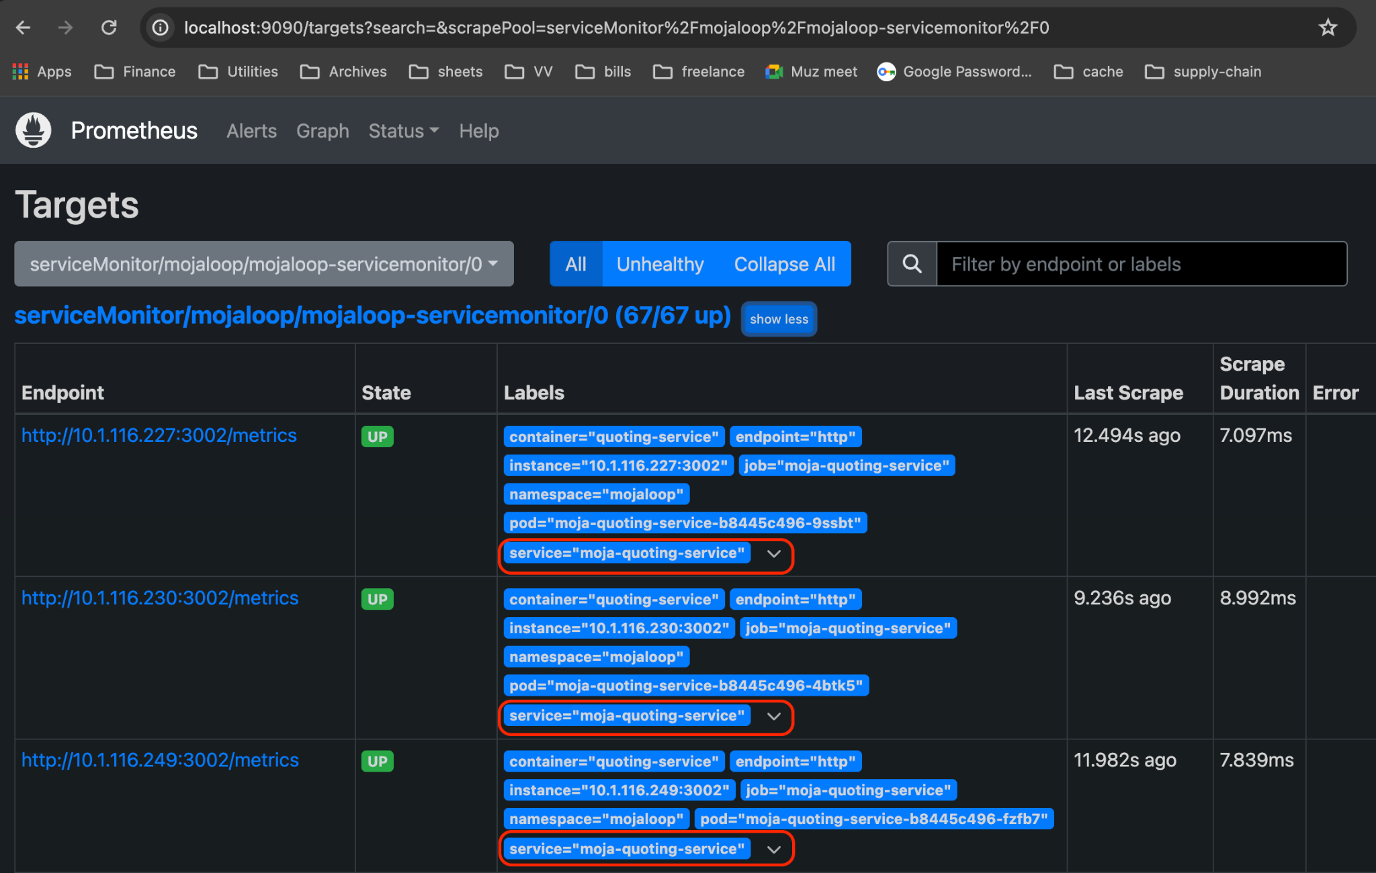
Confirm new service in Prometheus scrape targets
Go to prometheus targets
Select mojaloop service monitor
Look up service=<service-name>
Notes:
Once we have added our target service in the list, we want to be sure that it’s properly picked up by Prometheus. And in order to do that, we need to head over to “prometheus targets”, select the mojaloop-service-monitor and look into the list. Here you need to make sure that there exists an endpoint which has a label “service=your-service-name”. If that’s the case, it means Prometheus will now try to scrap your service.
In addition to that you will also get some other useful informations on this page e.g. what the current state of that target, what are the other labels and when was the last scrap performed. And you will see the error message in case of any error.
If you see “state=up”, then congratulations, it means Prometheus has been able to see your targets and will continue to scrap the metrics from this point onward.

Slide 14
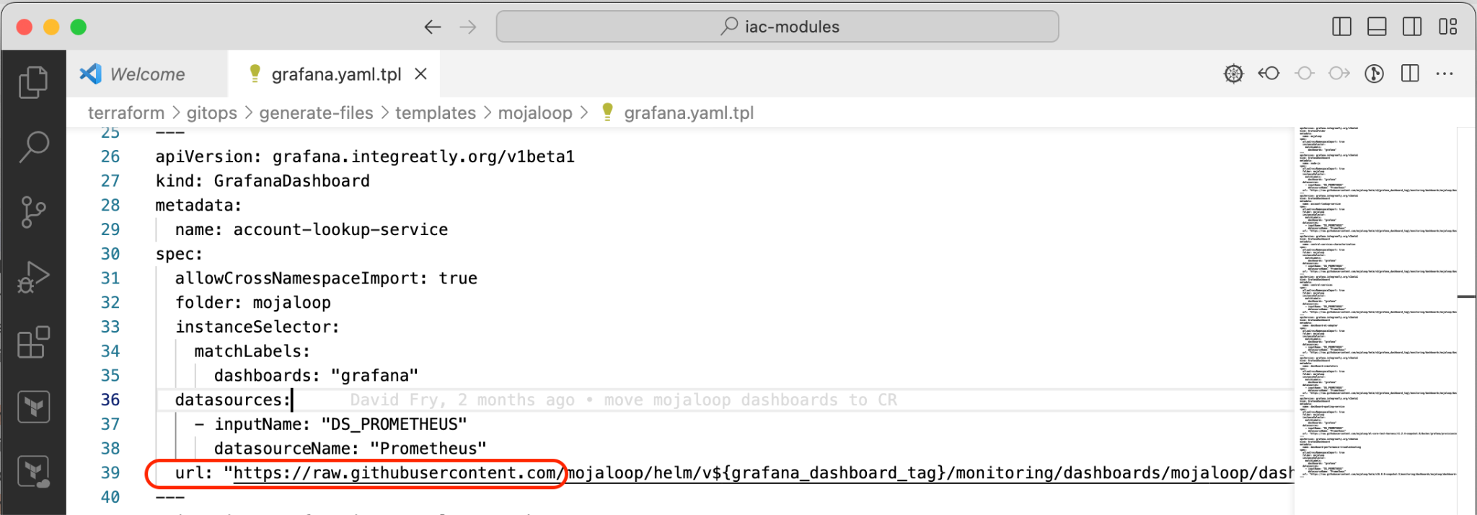
Importing the dashboard
Add custom resource GrafanaDashboard
Point it to target dashboard json
Sync to cluster
Notes:
So hopefully, everything went well up until this point and now it’s time we add our custom dashboard which shows all the important metrics related to service in a single pane of glass.
In order to do that, all we have to do is we need to make a custom resource of type “Grafana Dashboard” which points to the raw json of the dashboard.
Now we just need to sync this to our cluster and grafana operator is going to pick this up and automatically load the dashboard.

Slide 15
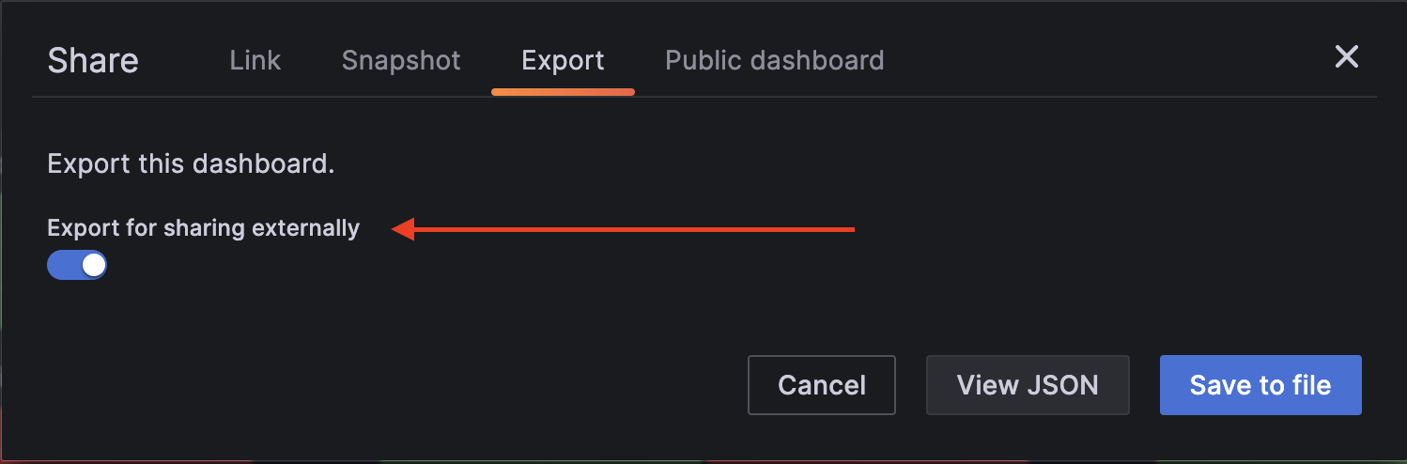
Dashboards - Gotcha # 1
Export for sharing externally should be enabled
Notes:
Caveats:
There are a couple of gotchas that you need to be aware of. The first one is make sure the option “Export for sharing externally” is enabled while exporting the dashboard. This will allow your dashboard to be used in clusters other than yours. This is particularly important if you are planning to donate your dashboards back to the community

Slide 16
Dashboards - Gotcha # 2
Ensure raw json reference
Notes:
The second one is that make sure you put the URL that references raw json content rather than link to the file in the repo. This can save you a lot of headache.

Slide 17
Overview - New Access Control Framework
Istio Stack Review
Ingress GW implementation for internal/external access, these components replace the nginx ingresses and the haproxy egress solution used in the past.
All mojaloop components that need to call external dfsp endpoints, route these calls through a local istio proxy sidecar that routes in turn to an istio egress gateway that is configured via CRs to use the appropriate client certificates to communicate with said endpoint.
IP filtering and are configured by use of the following Istio CRs:
The creation of these CRs is controlled by an agent listening to vault secrets generated by the Mojaloop Connection Manager component.

Slide 18
Overview - New Access Control Framework
Comparing Old WSO2 Stack to Istio
WSO2 API Manager and ISKM | Istio Stack
WSO2 was a monolithic server with many configuration files that needed to be manipulated and API calls executed post-installation in order to get a working API gateway | Istio stack provides an operator approach for managing ingresses and service mesh functionalities. After the installation of the core operators, configuration of security and networking is provided by installing custom resources along with the application they control.
WSO2 provides an API gateway functionality to ingress traffic only | Istio provides controlling security and networking on both ingress and egress traffic as well as inter-service traffic within the cluster.
WSO2's API GW solution worked with ISKM, their own identity management solution. | Istio works in conjunction with any identity management solution.

Slide 19
Overview - New Access Control Framework
WSo2
Egress gateway by Istio
UI portals
Ingress gateway by Istio
Experience API services
Authentication by BOF
Connection Manager APIs
Authorization by BOF
FSPIOP APIs
Identity Server by keycloak

Slide 20
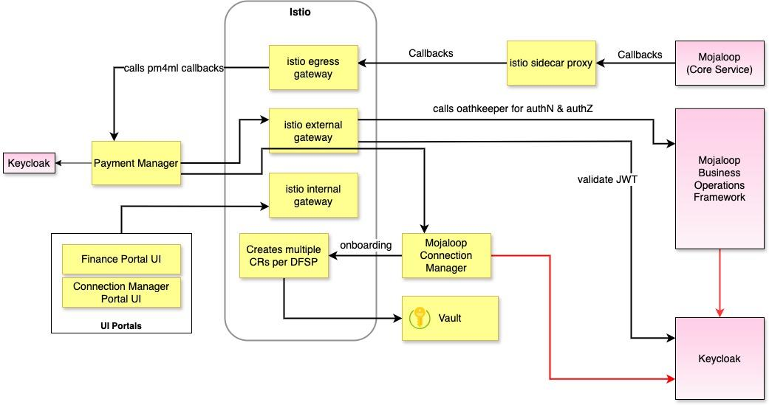
Deep Dive - New Access Control Framework

Slide 21
Access Control Framework - Example workflow
Define roles and permissions though configuration
Protect backend endpoint with a permission
Create users in Keycloak admin UI
Assign roles to users
Users login to the portals and can access only allowed API endpoints
1
2
3
4
5

Slide 22
On Premises Workstream Next-Steps
Complete removal of last remaining cloud dependencies from IaC control centre
Continue to iterate installation and maintenance documentation
Continue to support existing on-premises deployments
Continue to support upcoming on-premises deployments

Slide 23

Grateful thanks to all contributors!

Slide 24

Reach out to participate
Email: james.bush@mojaloop.io
Mojaloop Slack: #on-premises-deployment

Slide 25


